Slide 1
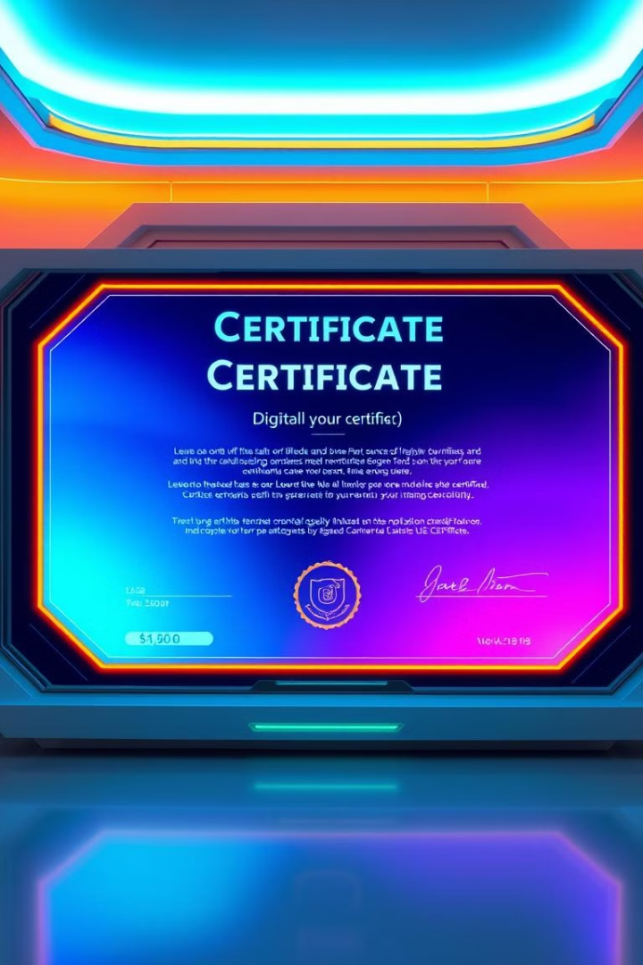

Blockchain-Based Certificate Generation and Validation System
This presentation outlines a blockchain-based platform designed for secure and efficient certificate generation and validation, addressing the shortcomings of traditional, centralized systems.
by Sujit Kumar

Slide 2

Introduction
Traditional certificate management methods suffer from vulnerabilities to forgery and loss, while verification processes are often slow and manual.
Document Forgery
Paper certificates are easily duplicated or altered, compromising their authenticity.
Loss or Damage
Physical certificates can be lost, damaged, or stolen, leading to inconvenience and potential fraud.
Slow Verification
Manual verification processes are time-consuming and prone to errors, hindering efficiency.

Slide 3

Objectives
Our goal is to develop a secure and efficient blockchain-based platform for certificate management, addressing the shortcomings of existing systems.
1
Decentralization
2
Tamper-Proof Verification
3
Efficient Interaction
Eliminate reliance on central authorities and ensure data immutability.
Guarantee the authenticity and integrity of certificates through blockchain technology.
Streamline the process of certificate issuance, verification, and user interaction.

Slide 4

Problem Statement
The existing certificate management system faces various challenges, including vulnerability to forgery, slow verification processes, and security risks associated with centralized storage solutions.
Challenges
Impact
Paper Certificates
Susceptible to loss, damage, and forgery.
Manual Verification
Time-consuming, prone to errors, and inefficient.
Centralized Storage
Vulnerable to breaches, single points of failure.

Slide 5
Review of Previous Work
Existing research has explored the use of blockchain and NFTs for certificate management, but challenges remain regarding cost, ownership, and technical implementation.
Zaman et al. (2023)
Hargude et al. (2021)
Utilized NFTs for digital certificates, but faced issues with high costs and ownership disputes.
Implemented dynamic QR codes and blockchain for certificate management, but encountered technical difficulties.

Slide 6
Proposed Methodology
Our approach leverages a secure blockchain network, decentralized storage, smart contracts, and user-friendly interfaces to create a robust and efficient certificate management system.
1
Blockchain Network
Utilizes Polygon blockchain for scalability and cost-effectiveness.
2
Decentralized Storage
Leverages IPFS for secure off-chain storage of certificate data.
3
Smart Contracts
Implements Solidity-based smart contracts for certificate issuance and validation.
4
Frontend
Uses React and Node.js for user-friendly interactions and seamless integration.
5
Verification
Employs dynamic QR codes for real-time verification of certificate authenticity.
6
Security
Leverages blockchain's immutability to ensure tamper-proof certificates.

Slide 7




Solution Overview
The platform offers a decentralized solution for certificate generation and validation, seamlessly integrating with IPFS and dynamic QR codes for secure and efficient verification.
Decentralized Platform
Certificate issuance and validation managed through a secure blockchain network.
IPFS Integration
Decentralized storage ensures data integrity and immutability.
Dynamic QR Code
Enables real-time verification of certificate authenticity and validity.

Slide 8





Benefits
Our solution provides numerous benefits, including enhanced security, increased efficiency, and a scalable and decentralized infrastructure.
Security
Efficiency
Decentralization
Scalability
Blockchain's immutability ensures certificate integrity and prevents tampering.
Fast, automatic verification using QR codes streamlines the process.
Reduces reliance on central authorities and eliminates single points of failure.
Low-cost, scalable solution utilizing the Polygon network for high throughput.

Slide 9

Conclusion
Our blockchain-based certificate management system offers a secure, scalable, and efficient solution for managing certificates across various applications.
1
Summary
A comprehensive solution for secure and efficient certificate management, addressing industry challenges.
2
Future Scope
Further enhance security features and integrate additional blockchain technologies for advanced functionalities.

